Slide 1



Investigating Max Pressure Jump in Mixed Phase
Katta Naveen
Supervisor : Dr .Ritam Mallick

Slide 2

Introduction
We investigate the phase transition between hadronic to quark matter in the core of neutron stars by using a quadratic interpolation method.
By implementing a piecewise polytropic equation of state (EOS) for the hadronic and quark phases, we create a smooth transition across the mixed phase.
We are trying to learn how the smoothness of the transition behaves if we keep on changing the EoS.
And finally for a any given EoS can we determine the maximum smoothness of the mixed phase.

Slide 3
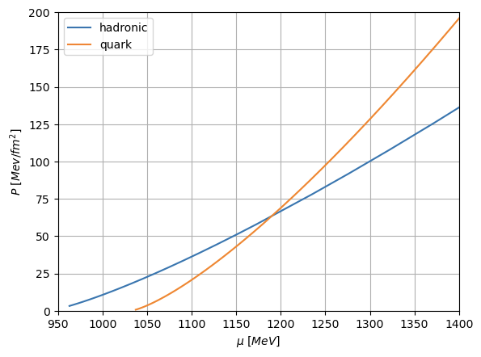
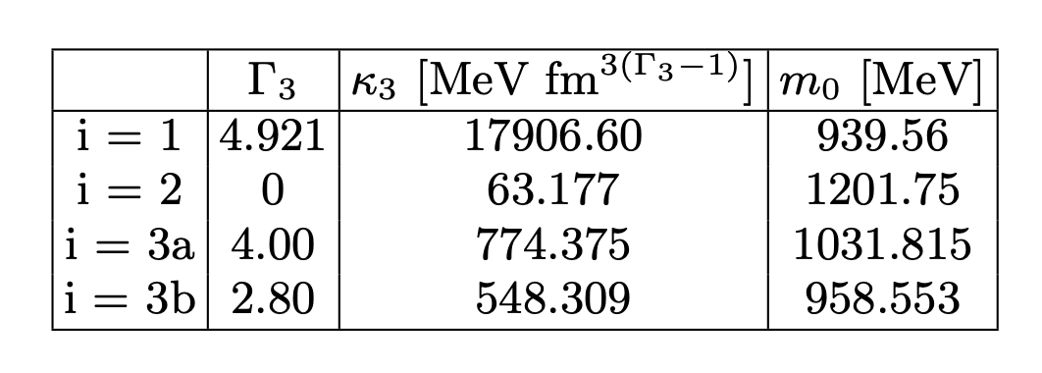
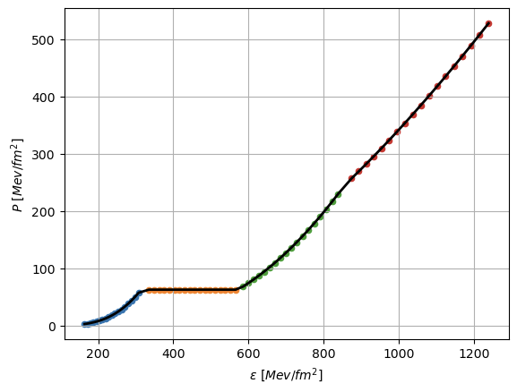
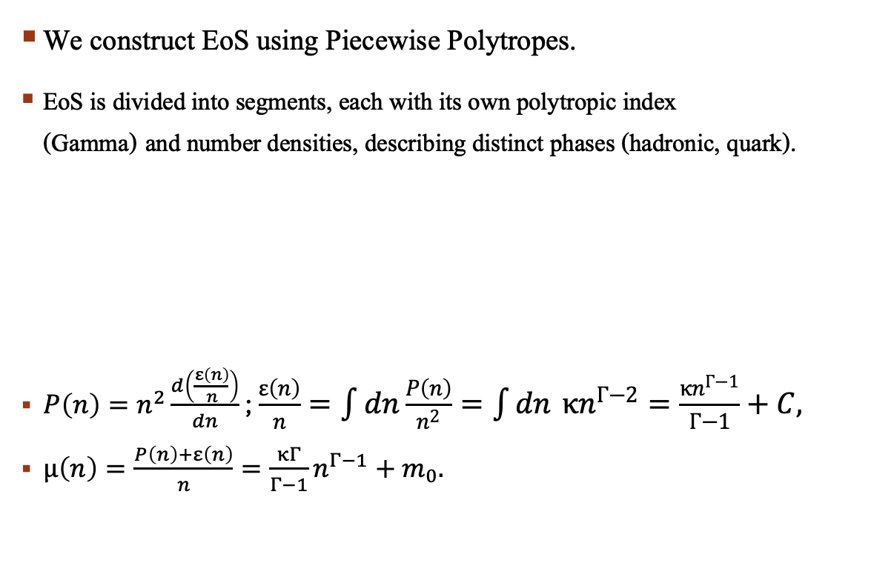
Constructing E0S
We construct EoS using Piecewise Polytropes.
EoS is divided into segments, each with its own polytropic index (Gamma) and number densities, describing distinct phases (hadronic, quark).
$P\left(n\right)=n^{2}\frac{d\left(\frac{ε\left(n\right)}{n}\right)}{dn}$ ; $\frac{ε\left(n\right)}{n}=\int{dn}\frac{P\left(n\right)}{n^{2}}=\int{dn} κn^{Γ−2}=\frac{κn^{Γ−1}}{Γ−1}+C,$
$μ\left(n\right)=\frac{P\left(n\right)+ε\left(n\right)}{n}=\frac{κΓ}{Γ−1}n^{Γ−1}+m_{0}.$

Slide 4
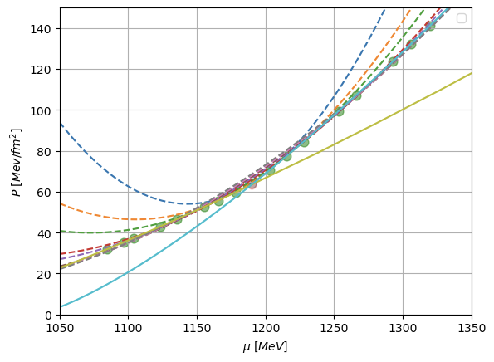
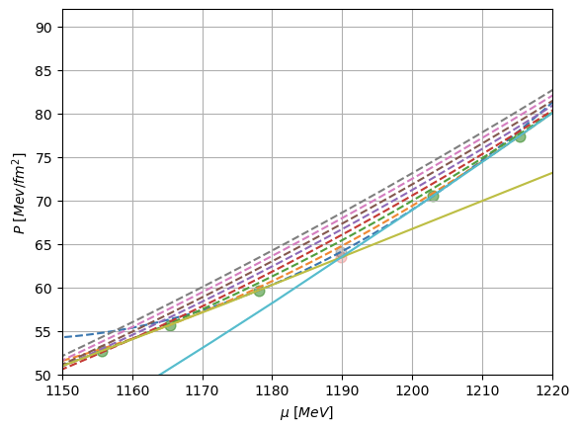
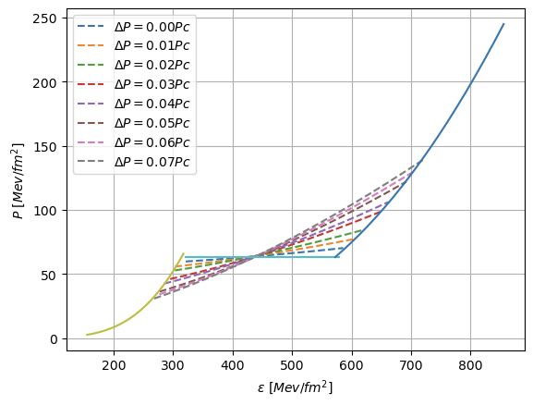
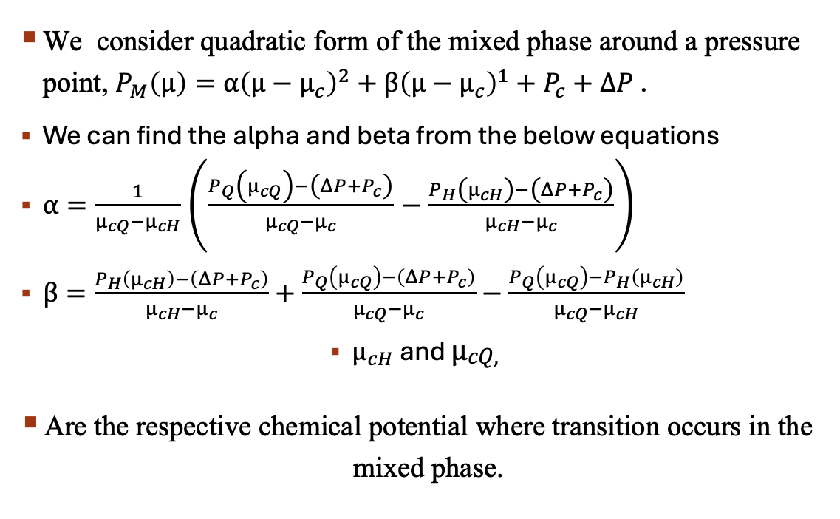
Quadratic interpolation
We consider quadratic form of the mixed phase around a pressure point, $P_{M}\left(μ\right)=α{\left(μ−μ_{c}\right)}^{2}+β{\left(μ−μ_{c}\right)}^{1}+P_{c}+ΔP$ .
We can find the alpha and beta from the below equations
$α=\frac{1}{μ_{cQ}−μ_{cH}}\left(\frac{P_{Q}\left(μ_{cQ}\right)−\left(ΔP+P_{c}\right)}{μ_{cQ}−μ_{c}}−\frac{P_{H}\left(μ_{cH}\right)−\left(ΔP+P_{c}\right)}{μ_{cH}−μ_{c}}\right)$
$β=\frac{P_{H}\left(μ_{cH}\right)−\left(ΔP+P_{c}\right)}{μ_{cH}−μ_{c}}+\frac{P_{Q}\left(μ_{cQ}\right)−\left(ΔP+P_{c}\right)}{μ_{cQ}−μ_{c}}−\frac{P_{Q}\left(μ_{cQ}\right)−P_{H}\left(μ_{cH}\right)}{μ_{cQ}−μ_{cH}}$
$μ_{cH}$ and $μ_{\begin{aligned}cQ, \\ \end{aligned}}$
Are the respective chemical potential where transition occurs in the mixed phase.

Slide 5
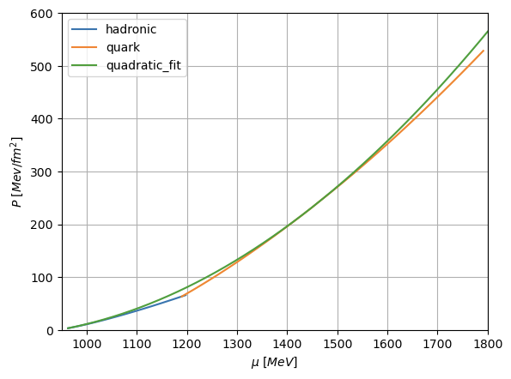
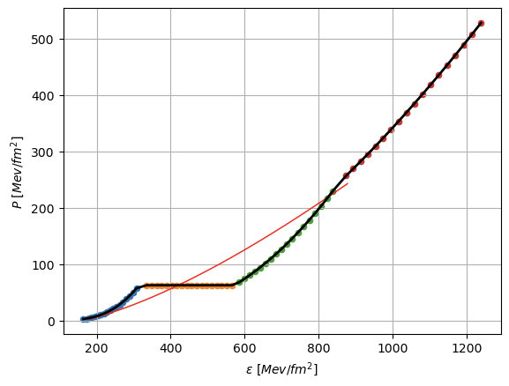
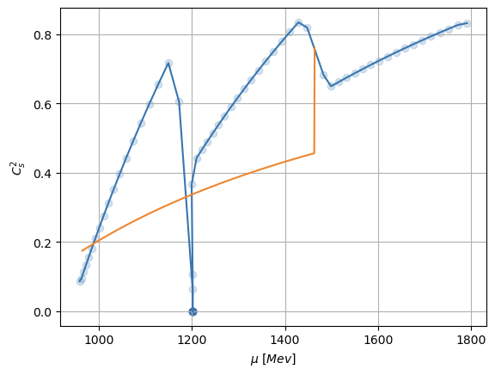
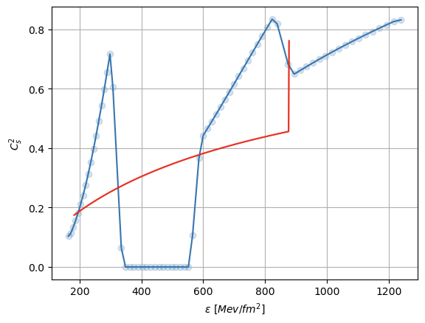
MAXIMUM INTERPOLATION ACHIEVABLE
Now we will keep the initial transition chemical potential to initial chemical potential of hadronic phase.
We develop a model such that it finds the optimal values of alpha and beta for such EoS.
Constraints of the Model : Equality constraint and Inequality constraint.

Slide 6
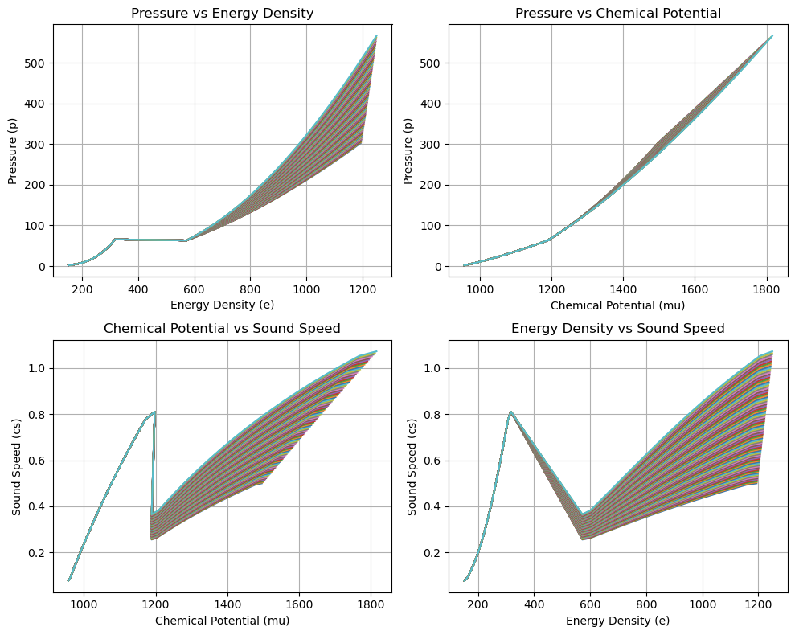
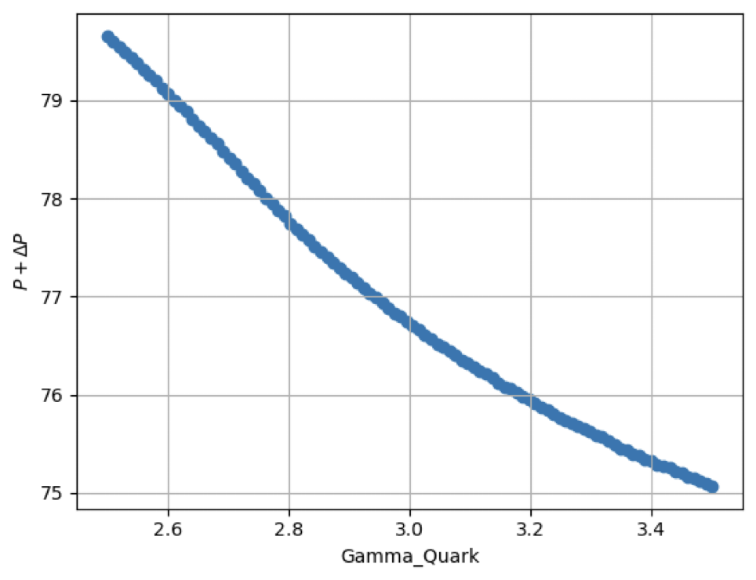
Impact of Different Polytropic Index
If we change the Gamma value of Quark, Polytrope changes so does the EoS, Gamma Quark is ranging from 2.5 to 3.5 .
Now if we find the maximum interpolation for these different EoS, we get the respective additional pressure terms.
So in the figure we can see that if we keep on increasing the polytrope index of quark the additional pressure term is keep on decreasing following a trendline.

Slide 7


Thank you
m

Slide 8
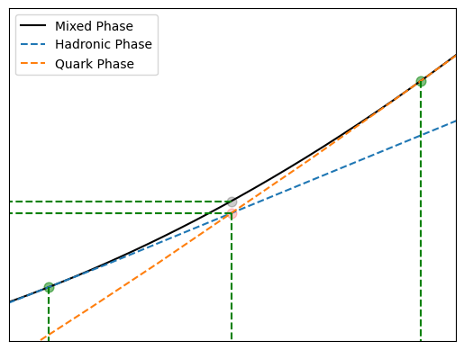
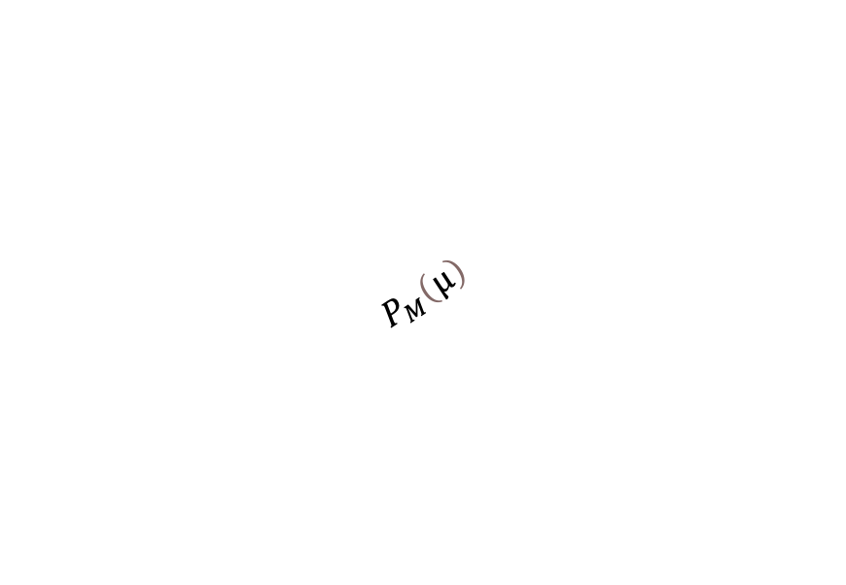
Pressure
$$P_{M}\left(μ\right)$$
$$P_{c}+ΔP$$
$$P_{c}$$
$$μ_{c}$$
$$μ_{cH}$$
$$μ_{cQ}$$
Chemical Potential

